Slide 1
Personality Traits
Self introduction
My self Sumaiya arif
I m a Friendly and hardworking person
I m cheerful an caring person
I m supportive person

Slide 2
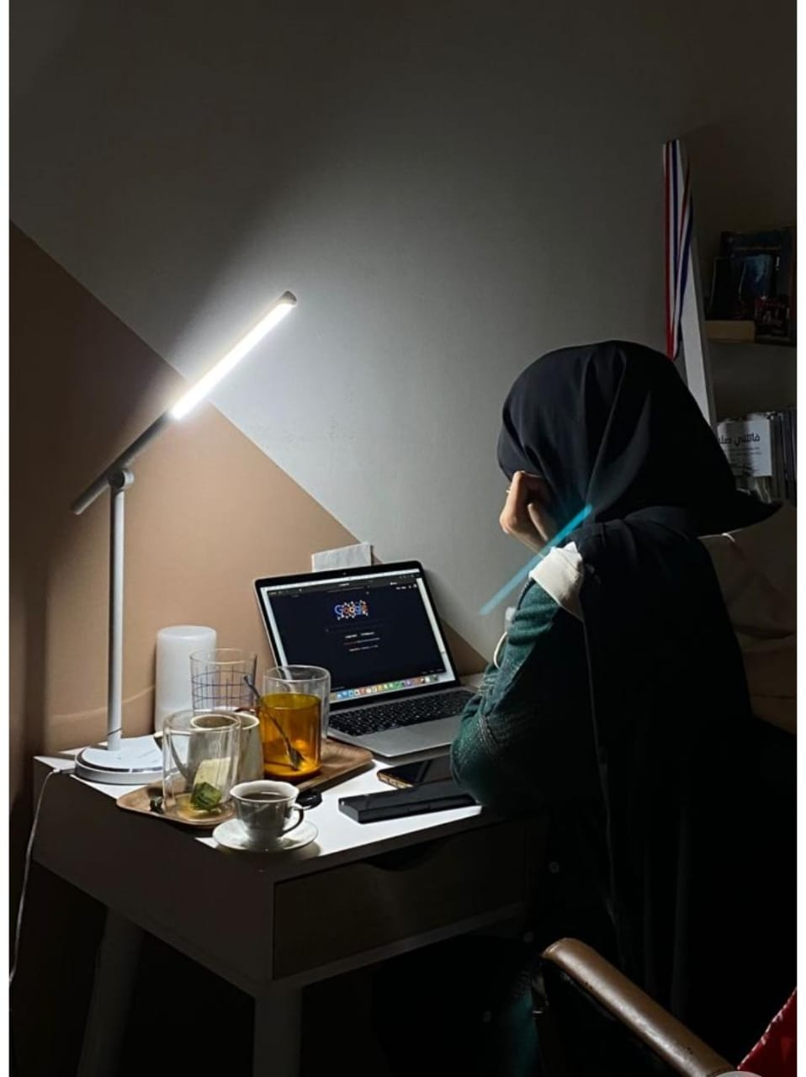
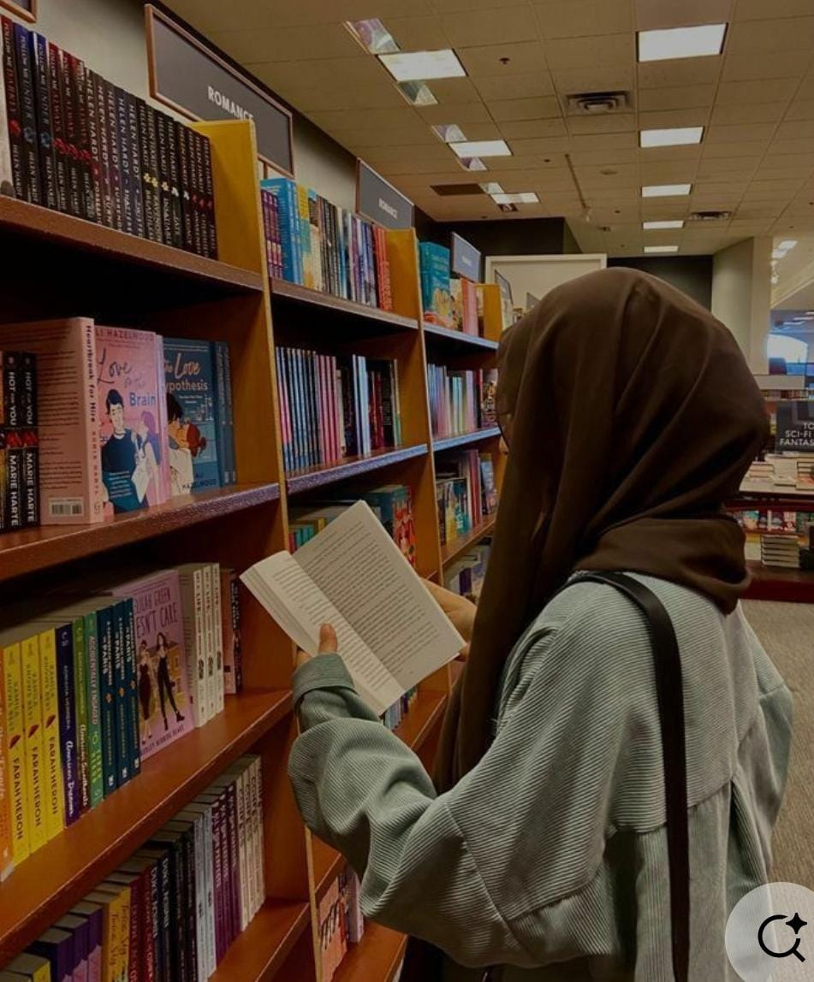
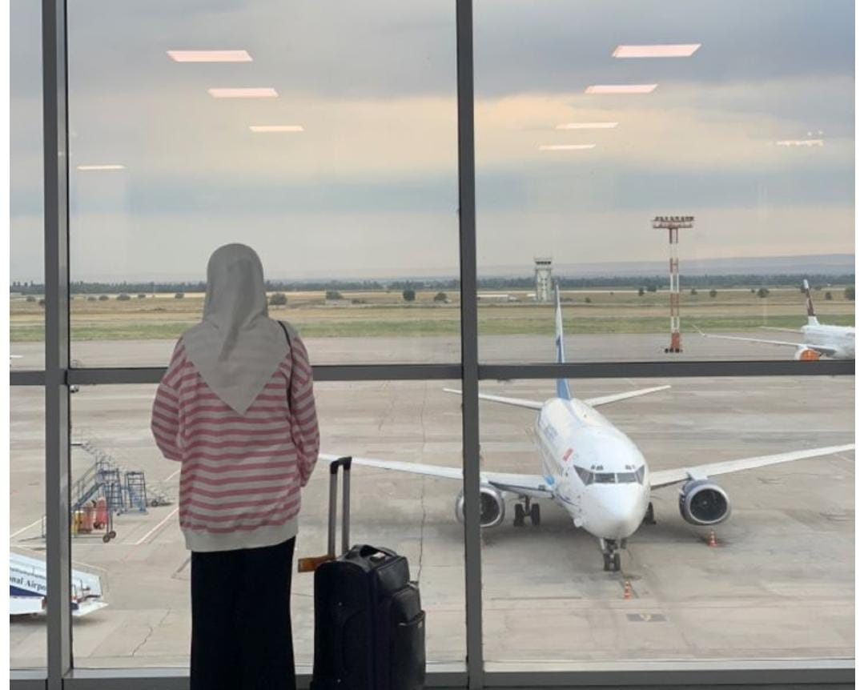
Hobbies & Interests
• Reading books 📚
• Exploring New Things💻
• Traveling 🌍

Slide 3

Academic/Personal Achievements
• Completed [dars-e-nizami] from zainab lilbnat
• Participated in callygraphy got a award

Slide 4
Skills Learned in this Course
In this course i laerned basic computer skills ms office
(word,excel, power point) basic programming
Favorite topic:
My favorite topic introduction to computer
My favorite tool is ms word

Slide 5
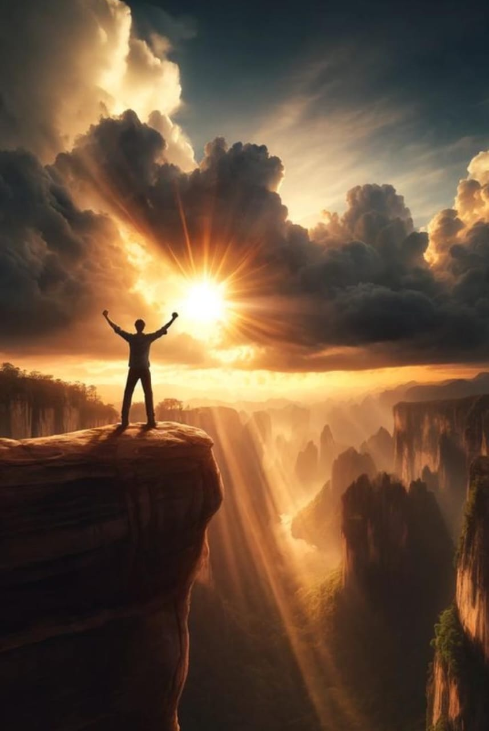
Strengths & Weaknesses
• Strength: i keep trying until i achive it
Weakness: low confident around a lot of

Slide 6

Future Goals
My goals iS to build a madarsa to spread a Islamic knowledge
Iwant Build a my own business and grow it
Role model : my mother my role model
Inspiration : my teacher my inspiration

Slide 7

Thank You 🙏
Fun fact: The footprint on the moon are still there because the moon has no wind and no rain

